Slide 1

Marathwada Mitra Mandal's
COLLEGE OF ENGINEERING, Karve Nagar, Pune - 52
An Autonomous Institute Affiliated to SPPU
Website: www.mmcoe.edu.in email id: mmcoe@mmcoe.edu.in
Department of Information Technology
Project Based Learning - Review 2 (AY 2025-26)
“EduBridge”
Presented By: <<SI154 Gaurav Jadhav>>
<<SI167 Shreyash Mandlapure>>
Name of Guide: Mrs. S P Vanjari
Date:
29/10/2025

Slide 2
CEP Project Title
Remote Classroom for Rural Colleges
Context of the project : Rural diploma colleges lack subject lecturers in fields like AI, VLSI, and renewable energy. Existing e-learning solutions fail due to unstable internet, high bandwidth requirements, costly infrastructure, and limited device compatibility. Area/Community of focus: Rural and semi-urban diploma colleges in India Students dependent on self-study and low-cost smartphones with limited data access Urban faculty providing remote expertise needing simple, low-cost teaching tools

Slide 3
Proposed Solution
Technology/Tools/Approach used
Frontend :
  React.JS
  Tailwind.CSS
  Typescript
Backend :
  Express.JS
Database :
  PostgreSQL
ML model training and dataset preparation​​
Custom dataset (2 classes):
📂 Engagement, 📂 Disengagement
Total images: 8000
Preprocessing:
Resized to 224×224
Rescaled pixel values to [0,1]
Split: 80% Training, 20% Validation
Framework: TensorFlow + Keras (on Kaggle)
Models Tested:
MobileNetV2 🟢
ResNet50 🔵
VGG16 🔴

Slide 4
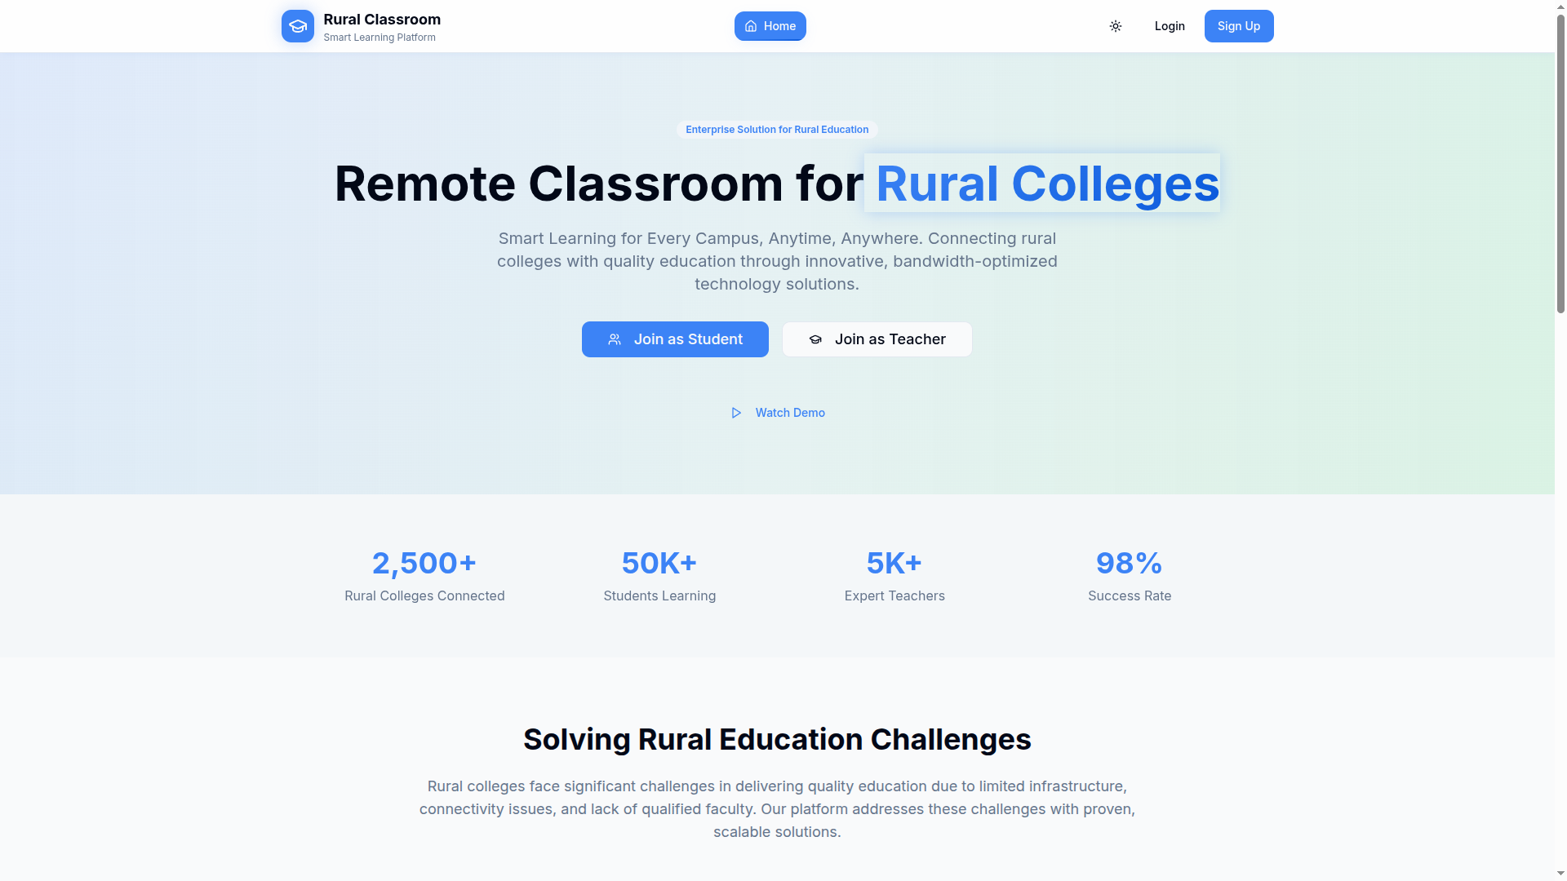
HomePage

Slide 5
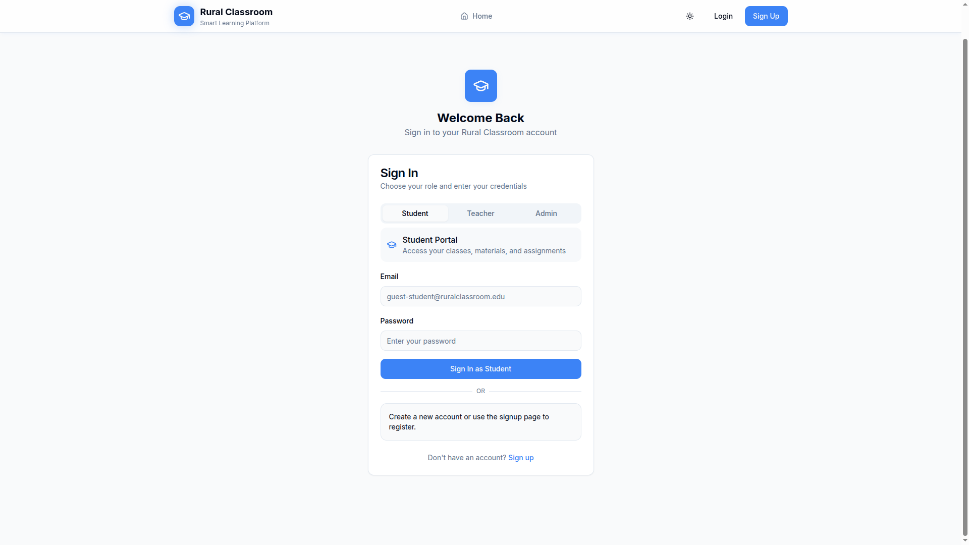
Login Page

Slide 6
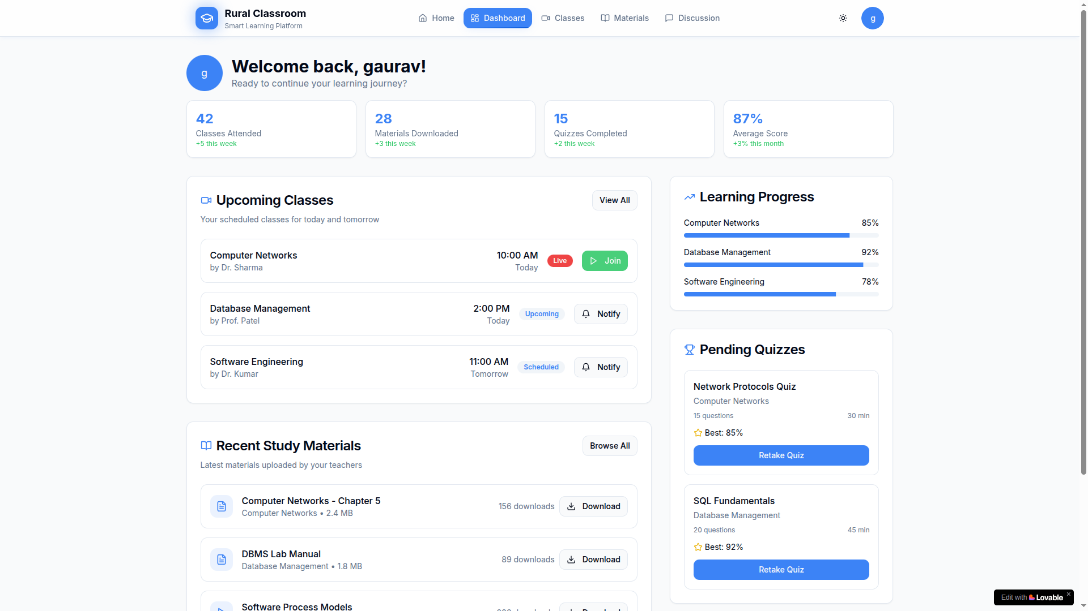
Student Dashboard

Slide 7
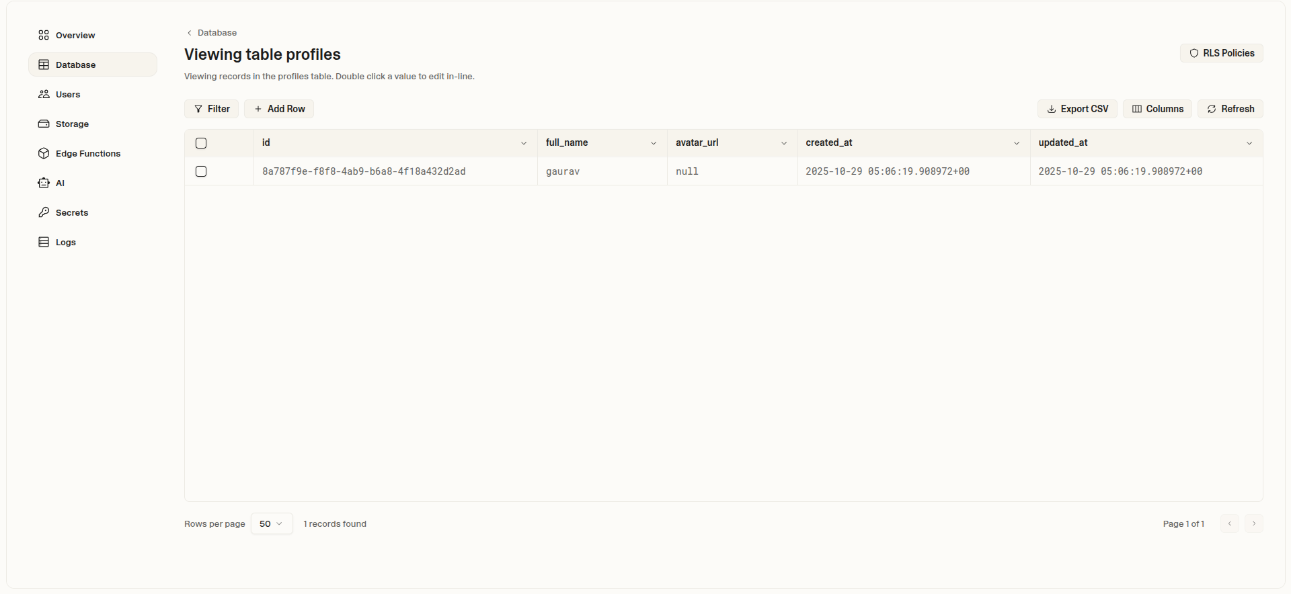
Admin Dashboard

Slide 8
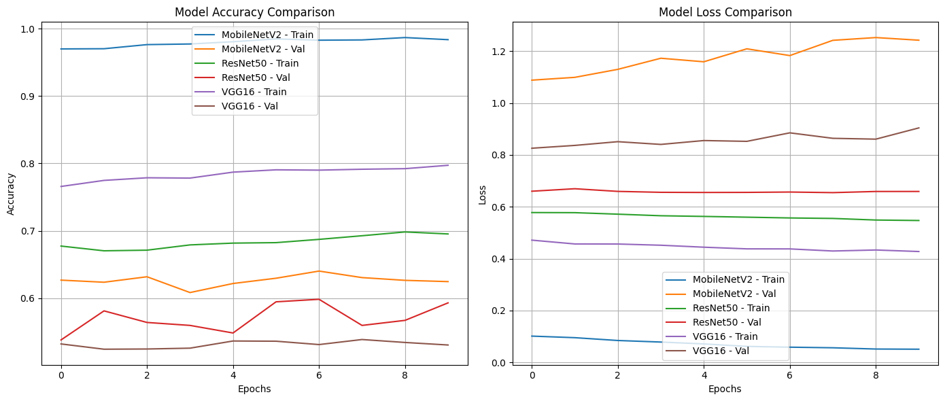
Accuracy & Loss Comparison
Kaggle Link -> https://www.kaggle.com/code/imgojo/face-engagement
All Models -> https://keras.io/api/applications/
Model | Validation Accuracy | Validation Loss
MobileNetV2 | 60.22% | 1.398
ResNet50 | 62.72% | 1.550
VGG16 | 59.22% | 1.779

Slide 9
Analysis
Model | Validation Accuracy | Validation Loss | Lightweight | Remarks
MobileNetV2 | 60.22% | 1.398 | Yes | Balanced; lower loss; fast training; ideal for real-time/rural classroom monitoring
ResNet50 | 62.72% | 1.550 | No | Slightly higher accuracy; heavier computation; best if hardware permits
VGG16 | 59.22% | 1.779 | No | Underperformed due to overfitting and high parameter count

Slide 10
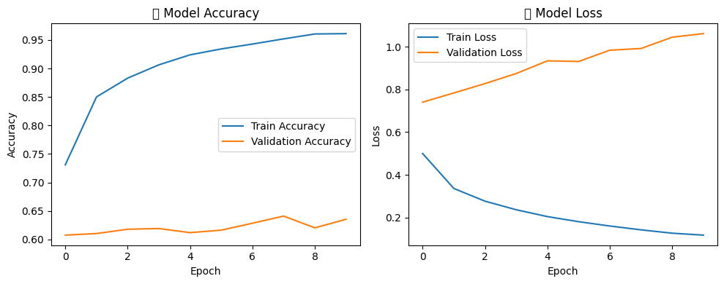
MOBILENETV2 MODEL SELECTION
WHY MOBILENETV2 IS IDEAL?
Designed for low-compute, low-power environments.
Requires less memory and processing time — perfect for mobile and edge devices.
Offers acceptable accuracy for real-time monitoring.
Best suited for deployment in rural setups with low-bandwidth connectivity.
Can run efficiently on entry-level smartphones or Raspberry Pi.

Slide 11
Feasibility and Sustainability
Can it be scaled or maintained?
✓ Cloud Infrastructure:
Auto-scaling server architecture​
Can handle 10,000+ concurrent sessions
Regional servers for faster access​
✓ Software-Only Approach:
No hardware dependencies​
Works on existing student/faculty devices​
PWA updates automatically (no manual updates)​
✓ Low Maintenance:
Automated monitoring and alerts
Minimal technical support needed​
Cloud-based recording storage (scalable)
Sustainability:
Partner with State Education Departments​
Government subsidized deployment​
Freemium model: Basic free, Premium features paid
Corporate CSR funding opportunities​
NGO partnerships for rural implementation

Slide 12
Feasibility and Sustainability
Cost and complexity
Estimated Implementation Cost (Per Institute):
Setup: ₹0 (software only)​
Cloud hosting: ₹5,000-10,000/month (100 students)
Bandwidth cost: Borne by users (affordable 2G/3G plans)​
Training: ₹15,000 one-time (2-day faculty workshop)​
Total first year: ₹75,000-1,35,000
Cost Comparison - Traditional Video Conferencing:
Enterprise licenses: ₹50,000-2,00,000/year​
High-speed internet: ₹20,000-50,000/month​
Hardware (cameras, mics): ₹50,000+​
Total: ₹3,00,000-8,00,000/year

Slide 13
Final Outcome
Before comparison
No access to specialist faculty in AI, VLSI, Renewable Energy​
Students travel 50-100 km for coaching (₹5,000-10,000/month)​
Outdated self-study materials​
High dropout rates in technical courses​
Urban-rural knowledge gap increasing​
Limited career opportunities
After comparison
Direct access to expert faculty from cities​
Learn from home (zero travel cost)​
Live + recorded lectures available​
Interactive learning with polls/quizzes​
Improved course completion rates (target: +40%)
Better job placement opportunities​
Bridging urban-rural education divide

Slide 14
Team Contributions and Learning
Role of each member
Gaurav Jadhav :
Collecting and creating the dataset
Refining the dataset
Training the models which are necessary
Research/Survey Proposal Paper
Shreyash Mandlapure :
Frontend (UI - UX)
Backend (DataBase)
Documentation(Diagrams - UML, Use Case, Activity, etc.)

Slide 15
Team Contributions and Learning
Reflection / Learnings
Technical Learnings:
Low-bandwidth optimization techniques​
  Opus codec implementation and tuning​
  WebRTC bandwidth estimation algorithms​
  Video codec comparison (VP8 vs H.264)​
Progressive Web App (PWA) development​
  Service workers for offline functionality​
  Cache strategies for educational content​​
Face detection and recognition (Gaurav)​​
  ML model training and dataset preparation​​
  MobileNet v3 for resource-constrained devices​
  Real-time processing optimization​
UI/UX & backend for low-end devices (Shreyash)​
  Responsive design principles​
  Accessibility considerations​
  Minimalist interface for faster loading
  Backend for server process and users request
  Database for managing users data

Slide 16
Team Contributions and Learning
Reflection / Learnings
Domain Knowledge:
Rural education challenges and constraints​
NEP 2020 guidelines for digital education​
Bandwidth limitations in rural India (2G/3G networks)​
User behavior in low-connectivity environments
Project Management:
Stakeholder engagement (students, faculty, colleges)​
Iterative development and testing​
User feedback incorporation​
Cross-functional collaboration

Slide 17
Team Contributions and Learning
Skills Learned
Gaurav Jadhav:
Deep Learning: Face detection model training​​
Computer Vision: OpenCV, facial recognition algorithms​
Dataset Management: Collection, cleaning, augmentation​
Research Skills: Academic paper writing
Cloud Deployment: Model serving on low-resource servers
Shreyash Mandlapure:
Frontend Development: React.js, PWA architecture​
Backend Development : Suprabase (PostgreSQL)
UI/UX Design: Figma, user research, prototyping
Mobile-First Design: Responsive layouts, touch interactions​
Documentation: UML diagrams, Use Case, Activity diagrams
Testing: User acceptance testing, accessibility testing

Slide 18
Future Scope
Future Scope
Use data augmentation and more samples to improve accuracy.
Add temporal tracking (using short video clips instead of stills).
Integrate with audio engagement cues (voice tone, response timing).
Deploy using Flask web app with offline fallback for rural classrooms.

Slide 19
Thank You

